Slide 1
Semantic Analysis and Clustering of Political Tweets
Solo Project by Bhargav Narasimha Shandilya
Piper Gradient (∇) GA Tech Summer 2021
bshandilya3@gatech.edu
GTID: 903638948

Slide 2
Contents
Introduction
Current Work:
Literature Survey
Working with the Data
Ethical Considerations
Future Work
Semantic Clustering of Tweets – An Algorithmic Approach
Ideas for Mitigating Ethical Risks
Evaluation Metrics
References

Slide 3
Introduction

Slide 4
Project Abstract
Social media giants such as Twitter and Facebook have fundamentally altered the way people consume news. While these powerful tools have empowered previously unheard voices, they have also amplified the outreach of individuals with a destabilizing influence on society. With no clear way to verify claims made on these social media sites, opinions on important political and social issues, ranging from vaccinations to election legitimacy, can become heavily polarized. This project aims to analyze a dataset consisting of Tweets related to a particular political issue in the United States.
The goal of the project is to place Tweets in clusters that are representative of the political orientation of the corresponding users who made the Tweets. These clusters can later be analyzed and appropriately labeled to derive insights that can help mitigate the alarming levels of polarization on social media. Various clustering approaches will be implemented and compared using appropriate evaluation metrics.

Slide 5
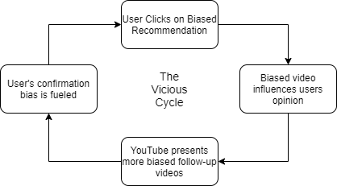
The Social Media Echo Chamber
The image below presents an example of a typical social media echo chamber on YouTube. These echo chambers are formed in a similar manner on sites such as Facebook and Twitter as well.

Slide 6
Inverting the Social Media Paradigm : Project Goal
While my project is restricted to the implementation and comparison of various text clustering algorithms on a dataset of Tweets, it might also be important to mention the long-term goal of the project as a whole. Once the clusters have been generated, topic analysis and text summarizations can be carried out for each cluster. This can be complimented by effective high-level representations of tweets in specific categories.
To maintain an unbiased atmosphere on social media, users can be recommended posts or videos from all of the relevant clusters instead of a single cluster. As political opinions get dispersed over news feeds, polarization should (theoretically) reduce. This is obviously an over-simplification of both the problem and the solution. A more detailed discussion will be carried out in subsequent sections.
The pretext of this problem and the proposed solution lead to several ethical considerations as well. While the analytical approach to clustering might be one of the primary tasks, a thorough exploration of the ethical use of the insights obtained through data analysis forms the crux of the project. The dangers of making policy decisions based on seemingly promising analytical results are also discussed in this project.

Slide 7
Literature Survey

Slide 8
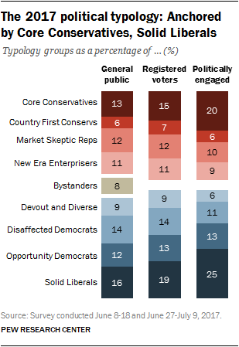
Classification of political orientation
The image on the left represents the political sub-categories in the democrat and republican camps as classified by the Pew Research Center in 2017 ^{[1]}. Each of these categories has a few distinct characteristics as well as many overlapping characteristics.
These characteristics include political engagement, perception of national institutions such as the courts, views on economic safety nets, etc.

Slide 9
Classification of political orientation (contd.)
Moderate Democrats
Non-Extremist
Independents
Moderate Republicans
Progressives
Libertarians
Source: Piper Gradient Kick-off Presentation
This is another classification methodology proposed by the Piper Gradient team. Although we have been instructed to stick with the labels provided by the Pew Research survey, this political spectrum seems to be a better candidate for cluster labeling. As discussed in a subsequent slide, the exercise of manually labeling a set of 300 tweets proved that it is very difficult to cast individuals into one of the 11 categories defined by the 2017 Pew Research survey.
Making a subjective judgement based on a single tweet that contains less than 280 characters is a challenging task for a human, let alone a deep learning model. As mentioned in the previous slide, each of the 11 bins is rigorously constructed based on complex socio-political factors. Therefore, it becomes difficult to place a single line tweet, which is sometimes riddled with expletives and emojis, into any of these bins.

Slide 10
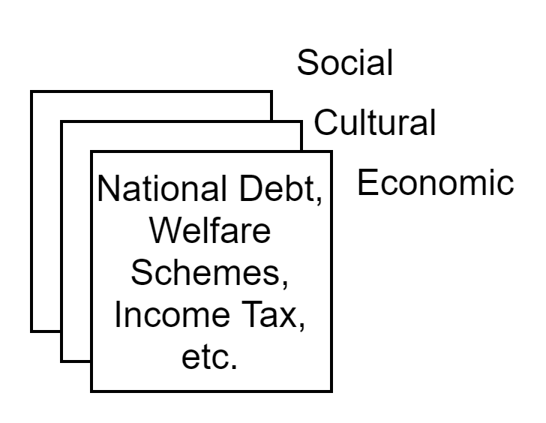
More Background Study on Political Ideology
In ^{[2]}, Carmines et. al., talk about the foundations of political ideology in America. After comparing the standard one-dimensional spectrums of political orientations with a more recent multi-dimensional approach to classification, they conclude that current mapping practices suffer from a myopic view. In this case, ‘multidimensionality’ refers to various dimensions of social and political issues. An individual might be ‘liberal’ on immigration policy and ‘conservative’ on socialized healthcare. While the Pew Research survey attempts to account for these by adding more categories on the same spectrum, it continues to classify all individuals into the conservative, liberal, or bystander clusters.
Although it could be argued that a one-dimensional classification is sufficient for the purpose of understanding overall political leanings and vote banks, it might not be relevant to a project that explores social media polarization. This hypothesis will be explored over the course of the project.

Slide 11
More Background Study on Political Ideology
The New Look in Political Ideology Research ^{[3]} argues that all political leanings can be categorized based on values and principles rather than any single ideology. The authors of this study also criticize the single-dimensional approach to political ideology.
How is this relevant to the project?
Based on these papers and other readings, I came to the conclusion that cluster labeling and evaluation does not have to be done based on allegiance to a political party. If the aim of the project is to address polarization on social media, reducing the solution to ‘liberal’ and ‘conservative’ tweet clusters might be problematic and unethical. Clusters would be more meaningful if they held contrasting opinions rather than a rigid dichotomy between democratic and republican viewpoints. In the evaluation phase, the clusters will be explored to see if the political spectrum proposed by the Pew Research Center serves as a proxy for these divisions in opinions. In other words, can this particular political lens be superimposed on the tweet clusters that are generated?

Slide 12
Clustering Techniques - Background Study
Soni et al [10] propose a k-means approach to sentiment extraction from textual data. [11], [12], and [13] suggest the popular DB-SCAN (Density-Based Spatial Clustering) approach specifically for Twitter data. Tweets are clustered on a flat basis for sentiment analysis.
[14] and [15] propose a soft approach to clustering. Instead of rigidly placing Tweets in clusters, using methods such as c-means and fuzzy clustering can give us probability scores for Tweets and the clusters they should belong to. This could be a more useful approach in this project since clustering is being conducted on volatile political ideologies based on scanty information.
Simple clusters for positive, negative, and neutral sentiments are obtained in [10] using a Naive Bayes approach.

Slide 13
Clustering Techniques - Background Study (contd.)
This project will also be attempting consensus clustering, a technique that involves the combination of various clustering techniques. The cascade of clustering algorithms used in [4] and [18] serve as some of the primary inspirations for the methodology adopted in this project.
[16] and [17] use hierarchical clustering techniques for topic detection. These algorithms will also be used in this project in the initial political topic clustering stage.
Across all the papers surveyed, maintaining high degrees of intra-cluster purity and identifying semantic elements like sarcasm or irony continued to be an issue. This problem is magnified when it comes to Tweets, since the data that is available in a single Tweet or a small set of Tweets is limited to a few characters.

Slide 14
Working With the Data (Current Progress)

Slide 15
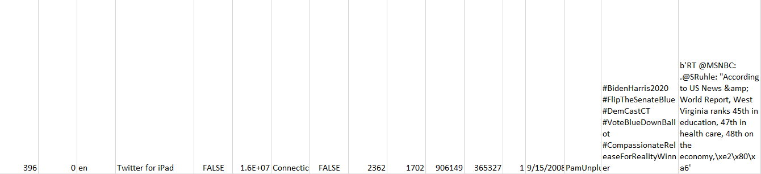
Nature of the data
The data consists of raw tweets related to the recent Infrastructure Bill that was proposed in the US. A sample row from the dataset is shown below. Only the last two columns are relevant to the clustering exercise. The last column depicts the Tweet itself, while the second last column depicts the user’s self-description on Twitter. It becomes quite clear from this example that the textual data is messy, and requires some cleaning.
User Bio
Tweet

Slide 16
The challenges of the early labeling exercise
Consider the challenge of manually labeling the Tweet shown on the previous slide. While it is somewhat clear that the individual supports the democratic party, it is impossible to classify the Tweet into one of the three democratic sub-categories outlined by the Pew Research Center typology.
For instance, a ‘Solid Liberal’ in Pew typology would be identified by high levels of activism after Trump’s election, contribution to political campaigns, and high levels of education among other factors. We would need information regarding the individual’s level of education, financial status, views on social safety nets, and levels of activism to make an accurate prediction. None of this information can be gleaned from the Tweet or the user’s bio.

Slide 17
Inherent Problems with the Dataset
Generalizability: Can a clustering exercise done for Tweets surrounding a single political issue generalize well for a wider set of issues? This might be unlikely.
Incomplete Data: Since special symbols and emojis are represented by nonsensical strings in the dataset, they will be removed as a part of the data cleaning process. This will adversely skew the results of the sentiment analysis that follows. Emojis and exclamation marks can provide important information on the degree of sarcasm in a Tweet.
Incoherency: The dataset contains several retweets. In some cases, the content of the Tweet is the same, but the user bios for the same Tweet are diametrically opposed to each other. This harkens back to the idea that political ideology can only be represented multi-dimensionally.

Slide 18
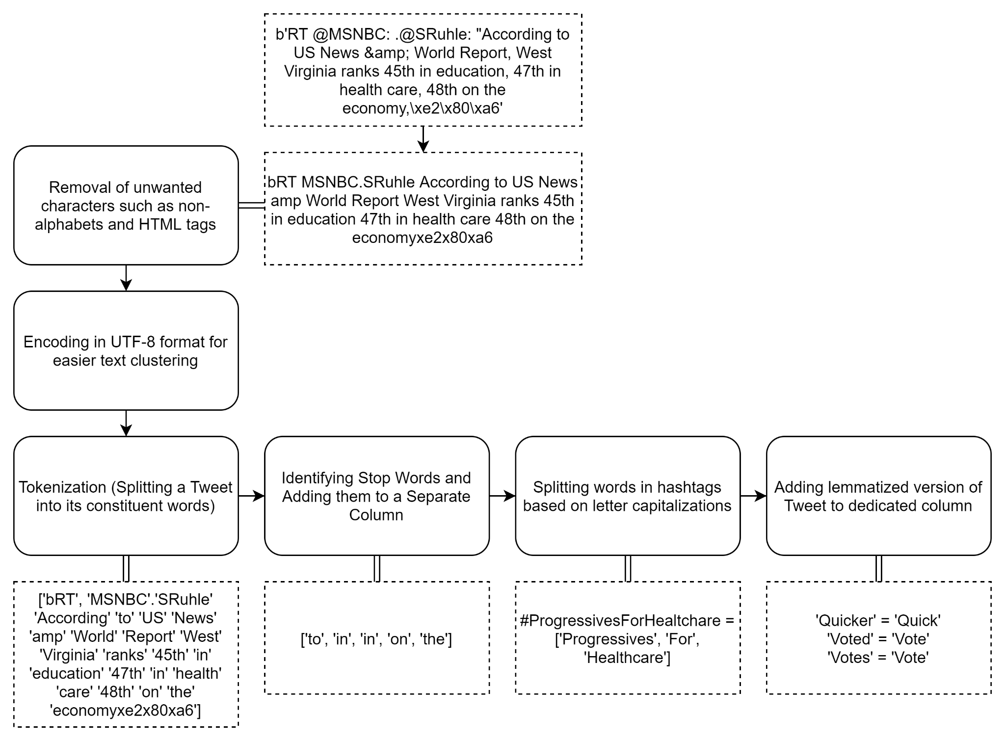
Data Pre-Processing
Inspiration for pre-processing Pipeline: Effectively Pre-processing the Text Data Part 1: Text Cleaning
By Ali Hamza
All of these pre-processing steps were carried out in Python 3.8 using the Numpy and NLTK libraries

Slide 19
Ethical Considerations
Papers such as ^{[20]} have shown that social media can have a massive impact on the perception of political figures and ideologies. This was widely seen during the recent US elections. Any project that intends to dabble in social opinion would naturally raise ethical concerns. Inspiration for this section is heavily drawn from the Nasa Framework for Ethical Use of AI ^{[21]}.
Leveraging third-party libraries for clustering: One of the future tasks before the final clustering exercise is the vectorization of words. Libraries such as word2vec and GloVe will be used to create vector representations of text. Words that are related or used in similar contexts (such as shoes and socks) will have a smaller L2 norm distance between their corresponding vector representations. However, vectorization cannot account for popular abbreviations in tweets such as ‘LOL’ or ‘SMH’. These abbreviations can be important semantic indicators that get left out, and the perceived meaning might be entirely different. Since these libraries are built through data-based approaches, they are known to negatively incorporate pre-existing human biases. These biases can include outright racism, homophobia, or sexism. For instance, people of a certain race may unfairly be associated with certain wrong stereotypes as a result of vectorization.

Slide 20
Ethical Considerations (contd.)
Problematic use cases: Social media already promotes the formation of online echo chambers. If the clustering exercise results in more focussed clusters, the results can potentially be used to increase engagement at the cost of even more polarization. By skipping text summarization showing users posts from only a single cluster, the problem of echo chambers could be exacerbated. This issue will be discussed in more detail in the final ethics report.
Risk to non-political posts: Deducing if a Tweet is entirely political or not is a problem by itself. Tweets that have nothing to do with politics or social issues might be perceived to be political simply because of the existence of certain terms. Once these Tweets enter the political pipeline, they will be subjected to unfair classification and summarization. Users might not see the Tweet in its original form altogether because of the polarization filter developed through this project.

Slide 21
Semantic Clustering of Tweets - An Algorithmic Approach (Future Work)

Slide 22
Topic Clustering and Sentiment Analysis
The clustering process will be divided into two parts:
Topic based clustering to obtain the sub-topics within a set of Tweets surrounding an issue. For instance, discussions on mass vaccination drives can be divided into sub-topics such as safety, efficacy of vaccine, patent protection laws, and big pharma taxation policy. The algorithm is allowed to determine the ideal number of sub-clusters instead of forcing a pre-defined number of clusters. Both soft and hard clustering approaches will be used and contrasted with each other. I intend to start with Latent Dirichlet Analysis (LDA) to determine topic clusters.
Sentiment analysis: Within each of these sub-clusters, sentiment analysis serves as an analog to political typology of Tweets. By accounting for the semantics post vectorization, TF-IDF scores ^{[4]} are used to determine the most frequently occurring terms. A graph-based approach (Louvain Method ^{[7]}) will be applied in parallel with the more common Naive Bayes approach. The results of both of these methods will be compared to determine the best set of topic and sentiment clustering algorithms.

Slide 23
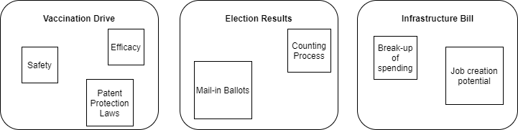
Topic-based Clustering

Slide 24
Ethics Report

Slide 25
Contents of the Ethics Report
The ethics report will be a detailed exploration of the following topics:
Potential pitfalls of using narrow data
Maintaining transparency throughout the clustering process
Avoiding the dangers of introducing personal political biases to results
Misuse of results
Weighing the benefits against the ethical risks of the project
Accounting for biases introduced by vectorization
Processes followed to ensure ethical design and analysis of the solution
Documentation of project goals and risks

Slide 26
Evaluation Metrics

Slide 27

Evaluation Metrics
Internal Criterion ^{[19]}: This is a measure of inter-cluster dissimilarity and intra-cluster similarity. It represents the ‘purity’ of a particular cluster. The ‘primary’ class of the cluster is the most frequently occuring class within a cluster. Purity is given by:
Here, omega is the set of all clusters and ‘l’ is the set of all classes. A dataset with political orientation labels for all the Tweets has been provided. The labels are not used during the clustering process itself. However, once the clusters have been formed, the degree of purity can be determined based on the labels of the Tweets in each cluster. The degree of purity would determine if the algorithm is capable of separating Tweets into the Pew Research categories. It would also highlight the relationship between different political typologies.
Normalized Mutual Information (NMI): The quality of the semantic partitioning achieved particularly by the Louvain Algorithm can be measured using NMI. By normalizing the more commonly used ‘Mutual Information’ criterion, we can avoid the bias towards choosing clustering results with a larger number of communities.

Slide 28

Rand Scores ^{[22]}: Since multiple clustering algorithms are being applied to the same task, the Rand Score can be used as an evaluation metric to determine the similarities between two different clustering results.
Here, TP = True Positives, TN = True Negatives, FP = False Positives, and FN = False Negatives

Slide 29
References

Slide 30
[1] Pew Research Center - Political Typology Reveals Deep Fissures on the Right and Left - https://www.pewresearch.org/politics/2017/10/24/political-typology-reveals-deep-fissures-on-the-right-and-left/
[2] Carmines, Edward & Ensley, Michael & Wagner, Michael. (2012). Political Ideology in American Politics: One, Two, or None?. The Forum. 10. 1-20. 10.1515/1540-8884.1526.
[3] The New Look in Political Ideology Research Edward G. Carmines and Nicholas J. D'Amico
Annual Review of Political Science 2015 18:1, 205-216
[4] Harakawa, Ryosuke & Takimura, Shoji & Ogawa, Takahiro & Haseyama, Miki & Iwahashi, Masahiro. (2019). Consensus Clustering of Tweet Networks via Semantic and Sentiment Similarity Estimation. IEEE Access. PP. 1-1. 10.1109/ACCESS.2019.2936404.
[5] R. Zhang, W. Li, D. Gao and Y. Ouyang, "Automatic Twitter Topic Summarization With Speech Acts," in IEEE Transactions on Audio, Speech, and Language Processing, vol. 21, no. 3, pp. 649-658, March 2013, doi: 10.1109/TASL.2012.2229984.
[6] Atif Khan, Qaiser Shah, M. Irfan Uddin, Fasee Ullah, Abdullah Alharbi, Hashem Alyami, Muhammad Adnan Gul, "Sentence Embedding Based Semantic Clustering Approach for Discussion Thread Summarization", Complexity, vol. 2020, Article ID 4750871, 11 pages, 2020. https://doi.org/10.1155/2020/4750871
[7] De Meo, Pasquale & Ferrara, Emilio & Fiumara, Giacomo & Provetti, Alessandro. (2011). Generalized Louvain Method for Community Detection in Large Networks. International Conference on Intelligent Systems Design and Applications, ISDA. 10.1109/ISDA.2011.6121636.
[8] Siau, Keng & Wang, Weiyu. (2020). Artificial Intelligence (AI) Ethics: Ethics of AI and Ethical AI. Journal of Database Management. 31. 74-87. 10.4018/JDM.2020040105.
[9] 2020 US Presidential Election Twitter Sentiment Analysis by Shiyan Boxer - https://medium.com/shiyan-boxer/data-science-in-the-real-world-f32defac6f96

Slide 31
[10] S. Miyamoto, S. Suzuki, and S. Takumi, “Clustering in tweets using a fuzzy neighborhood model,” in Proc. IEEE Int. Conf. Fuzzy Systems, 2012, pp. 1–6.
[11] C. D. Boom, S. V. Canneyt, and B. Dhoedt, “Semantics-driven event clustering in twitter feeds,” in Proc. Workshop on Making Sense of Microposts, vol. 1395. CEUR, 2015, pp. 2–9.
[12] E. Baralis, T. Cerquitelli, S. Chiusano, L. Grimaudo, and X. Xiao, “Analysis of twitter data using a multiple-level clustering strategy,” in Model and Data Engineering. Springer Berlin Heidelberg, 2013, pp. 13–24.
[13] J. C. B., R. Ehrlich, and W. Full, “Fcm: The fuzzy c-means clustering algorithm,” Computers & Geosciences, vol. 10, no. 2, pp. 191 – 203, 1984
[14] Zadeh, L. A., Abbasov, A. M. & Shahbazova, S. N. Analysis Of Twitter Hashtags: Fuzzy Clustering Approach. Fuzzy Information Processing Society (Nafips) Held Jointly With 2015 5th World Conference On Soft Computing (WCONSC), 2015 Annual Conference of the North American, 2015. IEEE, 1-6.
[15] G. Ifrim, B. Shi, and I. Brigadir, “Event detection in twitter using aggressive ﬁltering and hierarchical tweet clustering,” in Proc.SNOWDC@WWW, 2014
[16] D. Muellner, “Fastcluster: Fast hierarchical, agglomerative clustering rou-tines for r and python,” Journal of Statistical Software
[17] S. Vega-Pons and J. Ruiz-shulcloper, “A survey of clustering ensemble algorithms,” Int. J. Pattern Recogn. Artif. Intell., vol. 25, no. 3, pp. 337–372, 2011
[18] Christopher D. Manning, Prabhakar Raghavan and Hinrich Schütze, Introduction to Information Retrieval, Cambridge University Press. 2008.
[19] Identifying and Avoiding Bias in Research - Christopher J. Pannucci, Edwin G. Wilkins Plast Reconstr Surg. Author manuscript; available in PMC 2011 Aug 1. Published in final edited form as: Plast Reconstr Surg. 2010 Aug; 126(2): 619–625. doi: 10.1097/PRS.0b013e3181de24bc

Slide 32
[20] Husak, Olviia & Fialka, Svitlana. (2018). SOCIAL MEDIA INFLUENCE ON PUBLIC OPINION AND YOUTH BEHAVIOR. 10.30525/978-9934-571-27-5_17.
[21] https://ntrs.nasa.gov/api/citations/20210012886/downloads/NASA-TM-20210012886.pdf - NASA Framework for Ethical Use of AI
[22] W. M. Rand (1971). "Objective criteria for the evaluation of clustering methods". Journal of the American Statistical Association. American Statistical Association. 66 (336): 846–850. doi:10.2307/2284239. JSTOR 2284239.

Slide 33
Summary of Current Progress
Literature Review: The literature survey covered political ideologies, ethical practices with AI, and several NLP methods for text clustering and semantic analysis. Some of the most important aspects of the survey are detailed in subsequent slides.
Data pre-processing
Initial exploration of ethical ramifications of the project
Development of an approach to clustering (including algorithm, evaluation metrics, and expected results)

Slide 34
Summary of Work to be Done
Implementation of clustering algorithms
Empirical comparison of topic-based and sentiment-based clustering algorithms
Analysis of results
Evaluation and comparison with expected results
Building an ethics framework and writing an ethics report

